Slide 1
Introduction to Database (Part A)
STID 3014 : Week 1

Slide 2
Objectives
Differentiate data and information
Differentiate file processing and database system
Explain database structure and the three-level architecture
Explain the evolution of database and the database system environment

Slide 3
Differences between Data and Information
Data are raw facts, i.e. telephone number, birth date, name, etc.
Data : building blocks of information
Information is produced by processing data
Information is used to reveal the meaning of data

Slide 4
Example of Data
Consider this list of facts:
Baker, Kenneth D. 324917628
Doyle, Joan E. 476193248
Finkle, Clive R. 548429344
Lewis, John C. 551742186
McFerran, Debra R. 409723145
Sisneros, Michael 392416582

Slide 5
Example of Data (cont.)
Still not information, but data in context to help users understand data.

Slide 6
Example of Information
Graphical displays turns data into useful information that managers can use for decision making and interpretation

Slide 7
Logically Related Data
Entity – a distinct object in the organization, i.e. a person, place, thing, concept, or event. E.g Student, Course
Attribute – a property that describes some aspect of entity. E.g Name, Code
Relationship – an association between entities. E.g Takes

Slide 8
File-based Systems
Collection of application programs that perform services for the end users (e.g. reports).
Each program defines and manages its own data.
Typically labelled and stored in cabinets, but can also be implemented as information system on top of the file system (with C/Java/Cobol…)

Slide 9
File-based System
HEA
Class System
Class File
Lecturer Data
Lecture Hall Data
Student Data
HEP
Students activity
System
Activities File
Activities Data
Student Data
Bursar
Scholarship
System
Scholarship
File
Student Data
Sponsor data

Slide 10
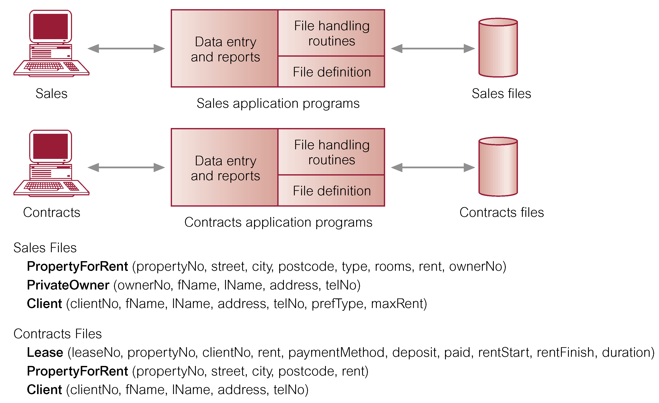
File-based Processing
Data redundancy

Slide 11
Limitations of File-based Approach
Separation and isolation of data
Each program maintains its own set of data.
Users of one program may be unaware of potentially useful data held by other programs.
Duplication of data
Same data is held by different programs.
Wasted space and potentially different values and/or different formats for the same item.

Slide 12
Limitations of File-based Approach (cont.)
Data dependence
File structure is defined in the program code.
Incompatible file formats
Programs are written in different languages, and so cannot easily access each others files.
Fixed Queries/Proliferation of application programs
Programs are written to satisfy particular functions. Any new requirement needs a new program.

Slide 13
Limitations of File-based Approach (cont.)
Definition of data was embedded in application programs, rather than being stored separately and independently. Eg. Next slide

Slide 14
Limitations of File-based Approach (cont.)
File System:
TYPE customer = RECORD
cid : CARDINAL;
name : ARRAY [1..20] OF CHAR;
city : ARRAY [1..20] OF CHAR;
balance: REAL;
rebate: REAL;
END;
Data definitions repeated in each program…
Database:
CREATE TABLE customers (
cid INTEGER CHECK (cid>0),
name VARCHAR(20),
city VARCHAR(20),
balance FLOAT,
rebate FLOAT );
Data definitions once in the central data dictionary of a Database.
=> Same for all applications

Slide 15
Limitations of File-based Approach (cont.)
No control over access and manipulation of data beyond that imposed by application programs. E.g next slide

Slide 16
Limitations of File-based Approach (cont.)
File System:
VAR o : order; p : product;
fh1, fh2: file_handle;
fh1 = Open(order_file);
WHILE NOT EOF(fh1) DO
o := getnext(fh1);
IF o.month = 10 AND o.day >= 19 THEN
fh2 = Open(product_file);
WHILE NOT eof(fh2) DO
p := getnext(fh2);
IF p.pnr=o.pnr AND p.stock<100 THEN
WriteCard(o.pnr, o.quantity);
END;
END;
close(fh2):
END;
END; close(fh1);
You have to program it by hand,
over and over and over …
Database:
SELECT pnr, quantity
FROM customers o, products p
WHERE o.month = 10 AND o.day >= 18
AND o.pnr = p.pnr
AND p.stock<100
Declarative queries
- easy to read and maintain
- usable from different
applications
- efficient evaluation due to
automatic optimization

Slide 17
Database Approach
Arose because:
Definition of data was embedded in application programs, rather than being stored separately and independently.
No control over access and manipulation of data beyond that imposed by application programs.
Result:
the database and Database Management System (DBMS).

Slide 18
Examples of Database Applications
Purchases from the supermarket
Online shopping
University portal

Slide 19
Database
Shared collection of logically related data (and a description of this data), designed to meet the information needs of an organization.
Logically related data comprises entities, attributes, and relationships of an organization's information.
Description of data known as System catalog (metadata or data dictionary) provides program–data independence.

Slide 20
HEA
Class System
Lecture Hall
Data
Database
Management
System
Lecturer Data
HEP
Students activity
System
Student Data
Activities Data
Bursar
Scholarship System
Sponsor Data

Slide 21
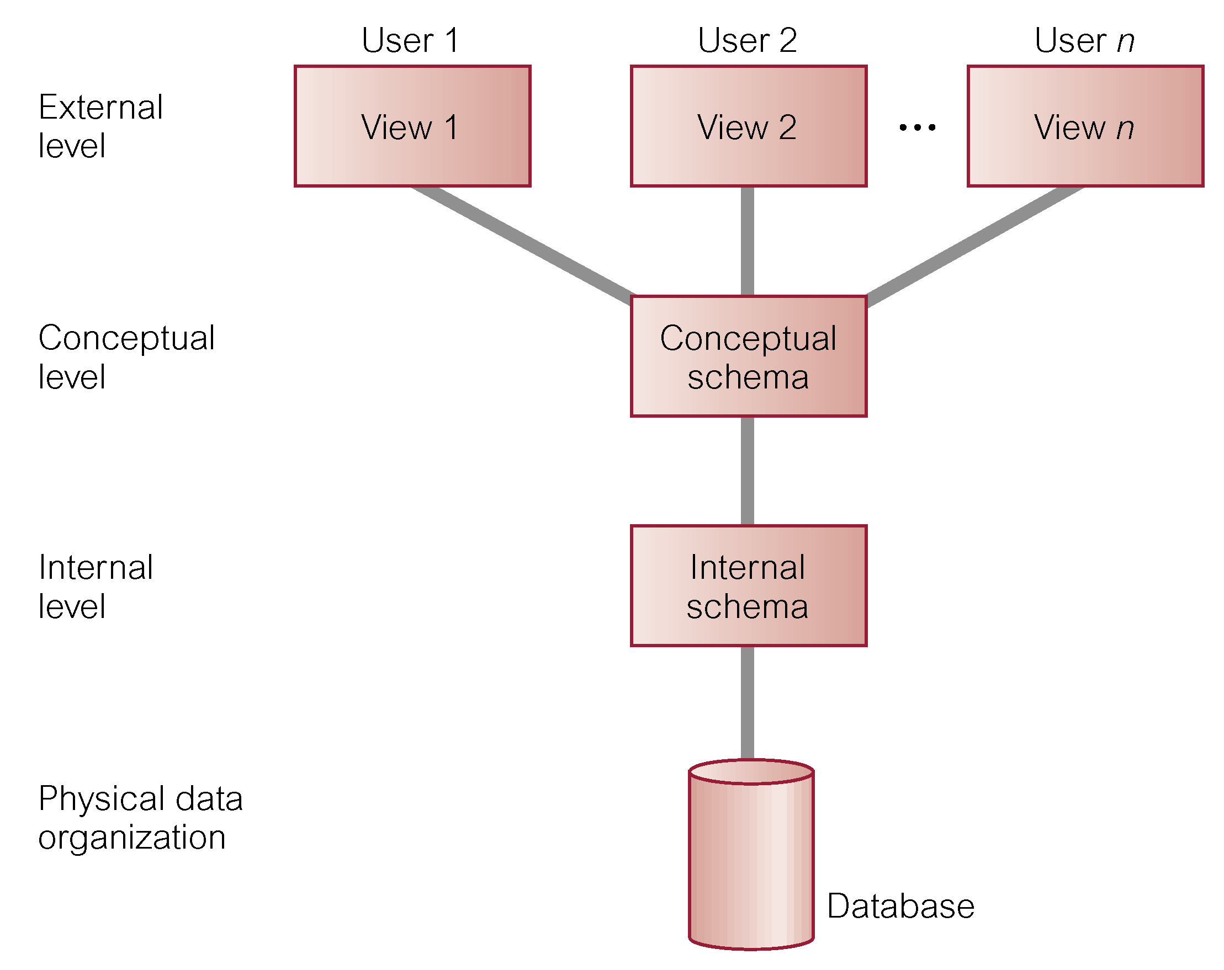
ANSI-SPARC Three-level Architecture

Slide 22
ANSI-SPARC Three-level Architecture
External Level
Users' view of the database.
Describes that part of database that is relevant to a particular user.
Conceptual Level
Community view of the database.
Describes what data is stored in database and relationships among the data.
Internal Level
Physical representation of the database on the computer.
Describes how the data is stored in the database.

Slide 23
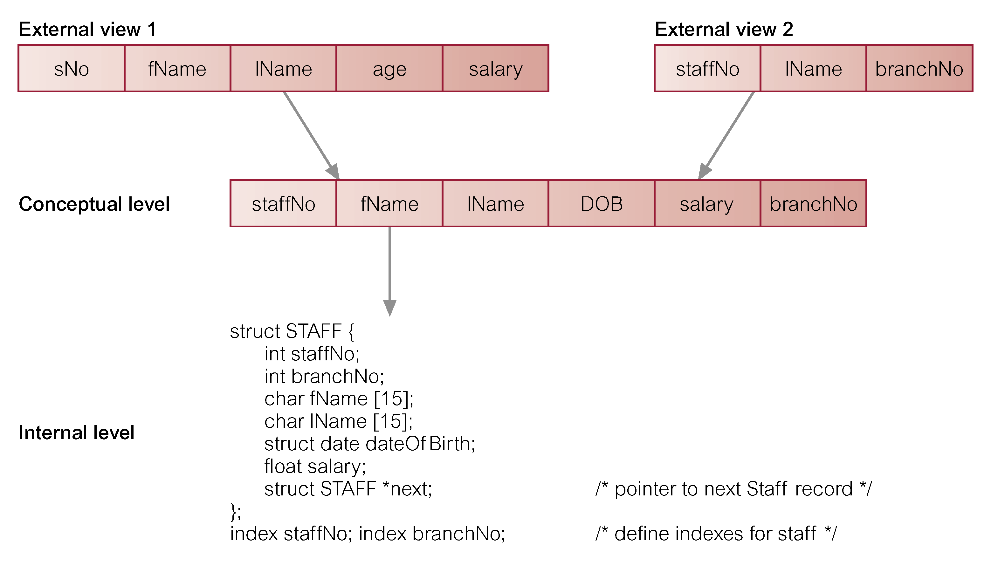
Differences between Three Levels of ANSI-SPARC Architecture

Slide 24
Objectives of Three-Level Architecture
All users should be able to access same data.
A user's view is immune to changes made in other views. e.g changes in application in User A won’t affect User B.
Users should not need to know physical database storage details.

Slide 25
Objectives of Three-Level Architecture
DBA should be able to change database storage structures without affecting the users' views.
Internal structure of database should be unaffected by changes to physical aspects of storage.
DBA should be able to change conceptual structure of database without affecting all users.

Slide 26
Major objective of Three-Level Architecture:Data Independence
means: the upper levels are unaffected by changes to lower levels
Logical Data Independence
Physical Data Independence

Slide 27
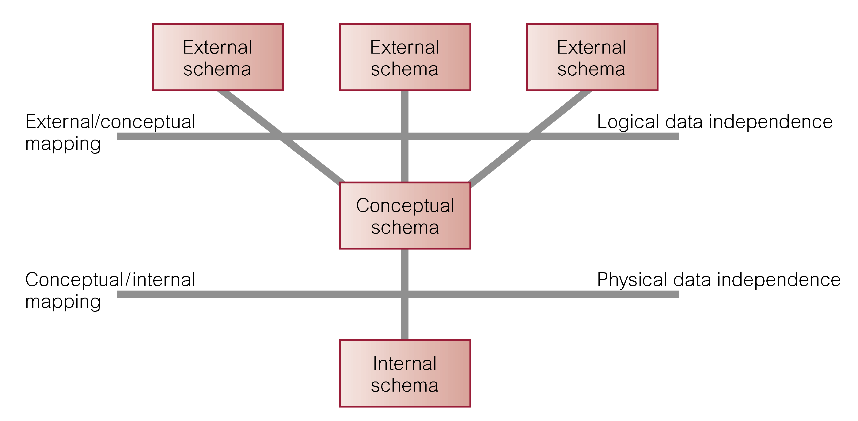
Data Independence and the ANSI-SPARC Three-level Architecture

Slide 28
Data Independence
Logical Data Independence
Refers to immunity of external schemas to changes in conceptual schema.
Conceptual schema changes (e.g. addition/removal of entities).
Should not require changes to external schema or rewrites of application programs.

Slide 29
Data Independence
Physical Data Independence
Refers to immunity of conceptual schema to changes in the internal schema.
Internal schema changes (e.g. using different file organizations, storage structures/devices).
Should not require change to conceptual or external schemas.

Slide 30
Evolution of Database Systems
First-generation
Hierarchical and Network
disadvantages: - complex programs
- minimal data independence
- no accepted theoretical foundation
Second generation
Relational
problems: limited modeling capabilities
Third generation
Object Relational
Object-Oriented

Slide 31
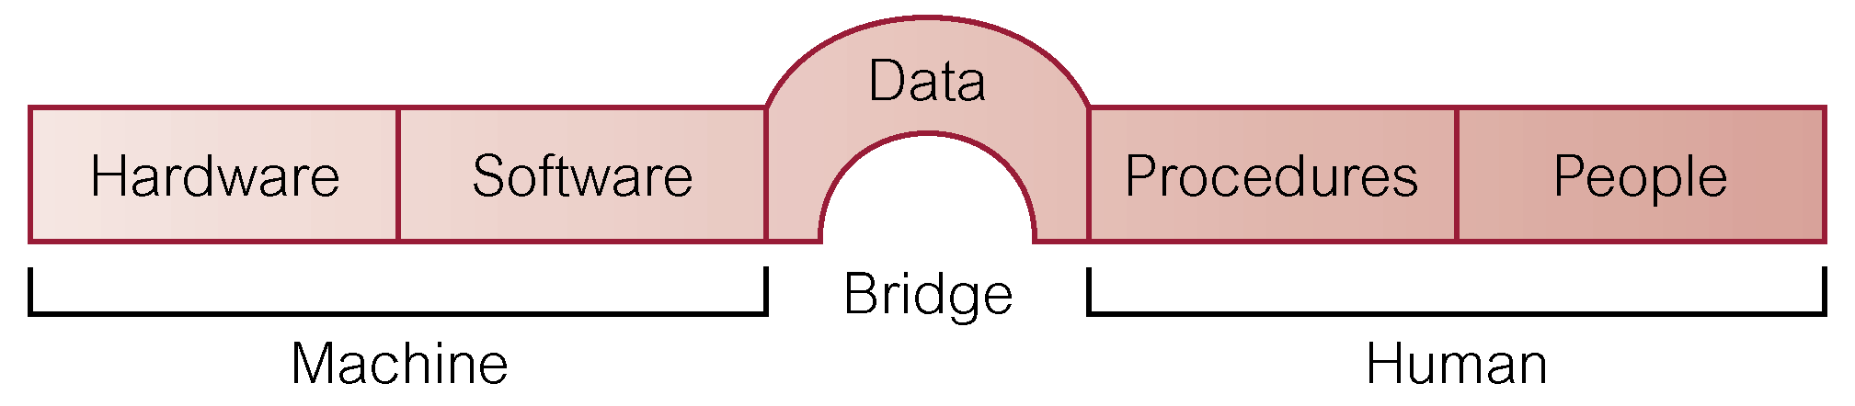
The Database System Environment

Slide 32
The Database System Environment
Hardware
Can range from a PC to a network of computers.
Software
DBMS, operating system, network software (if necessary) and also the application programs.
Data
Used by the organization and consists of operational data and the meta-data.

Slide 33
The Database System Environment
Procedures
Instructions and rules that should be applied to the design and use of the DBMS.
People (Roles in DBMS Environment)
Data Administrator (DA)
Database Administrator (DBA)
Database Designers (Logical and Physical)
Application Programmers
End Users (naive and sophisticated)

Slide 34
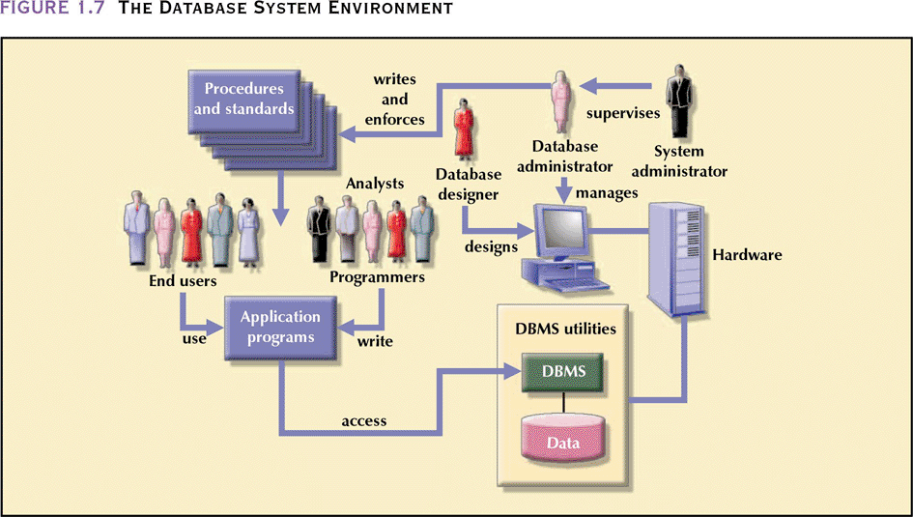
The Database System Environment
Database Systems: Design, Implementation, & Management, 6th Edition, Rob & Coronel

Slide 35
Database Management System (DBMS)
A software system that enables users to define, create, and maintain the database and which provides controlled access to this database.

Slide 36
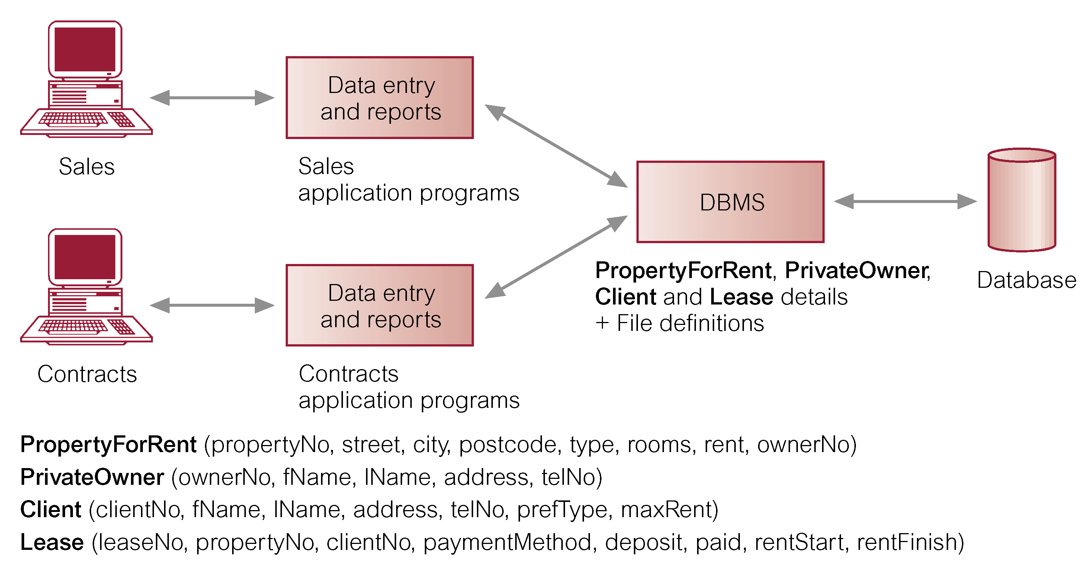
Database Management System (DBMS)
The DBMS Manages the Interaction Between the End User and the Database

Slide 37
DBMS Facilities
Data definition language (DDL)
Permits specification of data types, structures and any data constraints.
All specifications are stored in the database.
Data manipulation language (DML)
General enquiry facility (query language) of the data.

Slide 38
DBMS Facilities
Controlled access to database may include:
A security system – prevents unauthorized users accessing the d/b.
An integrity system – maintains the consistency of stored data.
A concurrency control system – allows shared access of the d/b.
A recovery control system – restores the d/b to a previous consistent state following a hardware or software failure.
A user-accessible catalog – contains descriptions of the data in the d/b.
A view mechanism.
Provides users with only the data they want or need to use.

Slide 39
Views
Allows each user to have his or her own view of the database.
A view is essentially some subset of the database.

Slide 40
Views
Benefits include:
Reduce complexity;
Provide a level of security;
Provide a mechanism to customize the appearance of the database;
Present a consistent, unchanging picture of the structure of the database, even if the underlying database is changed.

Slide 41
Advantages of DBMS
Control of data redundancy
Data consistency
More information from the same amount of data.
Sharing of data
Improved data integrity
Improved security
Enforcement of standards
Economy of scale

Slide 42
Advantages of DBMS
Balanced conflicting requirements
Improved data accessibility and responsiveness
Increased productivity
Improved maintenance through data independence
Increased concurrency
Improved backup and recovery services

Slide 43
Disadvantages of DBMS
Complexity
Size
Cost of DBMS
Additional hardware costs
Cost of conversion
Performance
Higher impact of a failure

